Slide 1
Title
Assignment Title
Bradley De’Ath
DEA18001355
Overall Word Count

Slide 2
Introduction
Basic Overview of The Brief (what is the purpose)
What I plan to do in the presentation (what am I looking at)
What Conclusions will I be drawing?

Slide 3
Business Overview
The Purpose of All-stars Sport Bar
Who are the Customers?
Main aims and objectives of the business
Where is the business

Slide 4
Analysis of Current Website
Who are the users?
How is it Laid out?
How did I analyse?
What features are on the site?
What is the purpose of the website?
Main areas to improve
https://www.emerald.com/insight/content/doi/10.1108/13287260910955129/full/html - reference

Slide 5
Process Improvement Opportunities
What is a business process?
Definition
What process does the site offer?
List 3 different processes that are on the site
Which processes need to be improved?
Pick 2 of the processes that need to be improved.
https://www.techopedia.com/definition/1168/business-process

Slide 6
Recommendations
List all recommendations for the site to be improved
Less Content for each page
Shorten the length of the page – Users have to scroll too much
Contact Page has error where if a form is entered incorrectly – Loser uses access to form and has to reload page
Contact Page Number-Verification is the same number for every form: no change

Slide 7
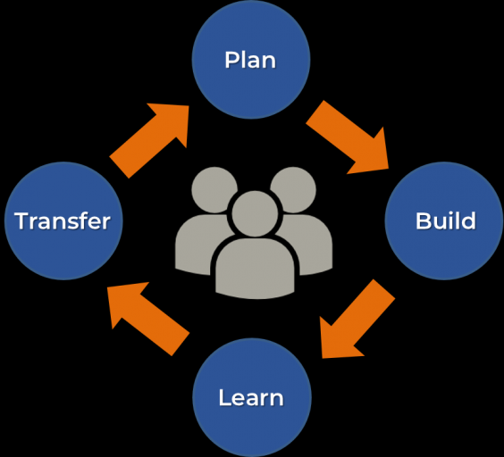
Proposed Web Development Methodology
The Continuous Development Cycle
Include Diagram
Why have I chosen this Methodology
https://www.emerald.com/insight/content/doi/10.1108/13287260910955129/full/html
https://skodaminotti.com/blog/continuous-improvement-extending-life-website/

Slide 8
Web Development Tools Evaluation
Two different IDEs
Google Maps Integration
Chrome Developer Tools
Which of these are suitable for this website?

Slide 9
Web Frameworks Evaluation
Find Four Different Web Frameworks
Compare them
HTML
CSS?
Bootstrap
Identify which are/aren’t suitable - why

Slide 10
Selection of Web Development Tools and Frameworks
Which of the Web Tools and Frameworks have I chosen to implement
Why?

Slide 11
Conclusion and Next Steps
Overall analysis of what I have covered
Key points
What are my next steps for implementation and creation

Slide 12
References
Full list of references
https://www.emerald.com/insight/content/doi/10.1108/13287260910955129/full/html

